Slide 1


Claude Builder Club @ University of Cambridge

Slide 2
Table of contents
What is Claude?
What is Claude Builder Club?
What is MCP?
Hands-on Session
What are Skills?
How to write effective Skills?
Hands-on Session

Slide 3
We founded Anthropic because we believe the impact of AI might be comparable to that of the industrial and scientific revolutions, but we aren’t confident it will go well. And we also believe this level of impact could start to arrive soon – perhaps in the coming decade."
“
Anthropic
Notes:
Anthropic is an AI research company that develops AI systems like the large language model Claude and there mission is to build AI that is reliable, interpretable, and beneficial to humanity.

Slide 4
People want AI to help them extend their thinking, not to think less
Perceptions of AI today
What people want from an AI relationship
“Right now, it’s like a vending machine: I input a prompt, it spits something out.”
“Sometimes I want it to help me think. Not just solve. Like a creative partner you bounce ideas off for hours.”
“A cheerleader is nice, but sometimes I want a sparring partner - that’s how ideas grow and that’s not what ChatGPT does today.”
“I don’t want an assistant. I want something that can help me get better at thinking, at writing, at strategy.”
SOURCE: Anthropic Positioning Research, July, 2025
Notes:
They want to build an AI that can help people think not just an assistant.

Slide 5
Where others promise easy answers, Claude provides the cognitive power to take on harder problems.
Claude is the AI for problem solvers.
The opportunity
Notes:
That’s why they built Claude which can provides the cognitive power to take on harder problems.

Slide 6
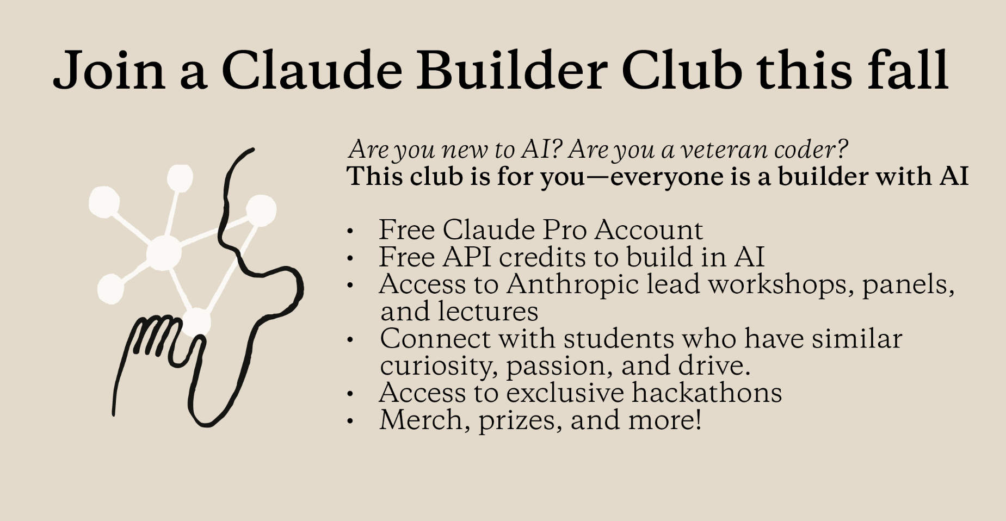
Notes:
As Claude Builder Club at the University of Cambridge, we’re going to give opportunities for students to learn and build something with Claude. (Explain benefits, events)

Slide 7




Join the Claude Builder Club
CBC is run by the Cambridge University AI Builder Club (CUABC).
To receive benefits and event notifications, you'll need to sign up for both the society and CBC using the QR codes below.
CBC Sign-up
Sign up today to become an official member of the Claude Builder Club
Get 6 months of Claude Pro free
Join member-exclusive events
CBC Check-in
Check in at CBC events
Receive $50 in Claude API credits (one-time offer)*
CUABC Sign-up
Sign up today to join CUABC and access community events, workshops, and learning opportunities
Sign up and join our Discord channel for event updates and announcements
CUABC Instagram
Follow us on Instagram to stay informed about CBC events and news

Slide 8
What is MCP?
Claude Builder Club – Model Context Protocol Workshop

Slide 9
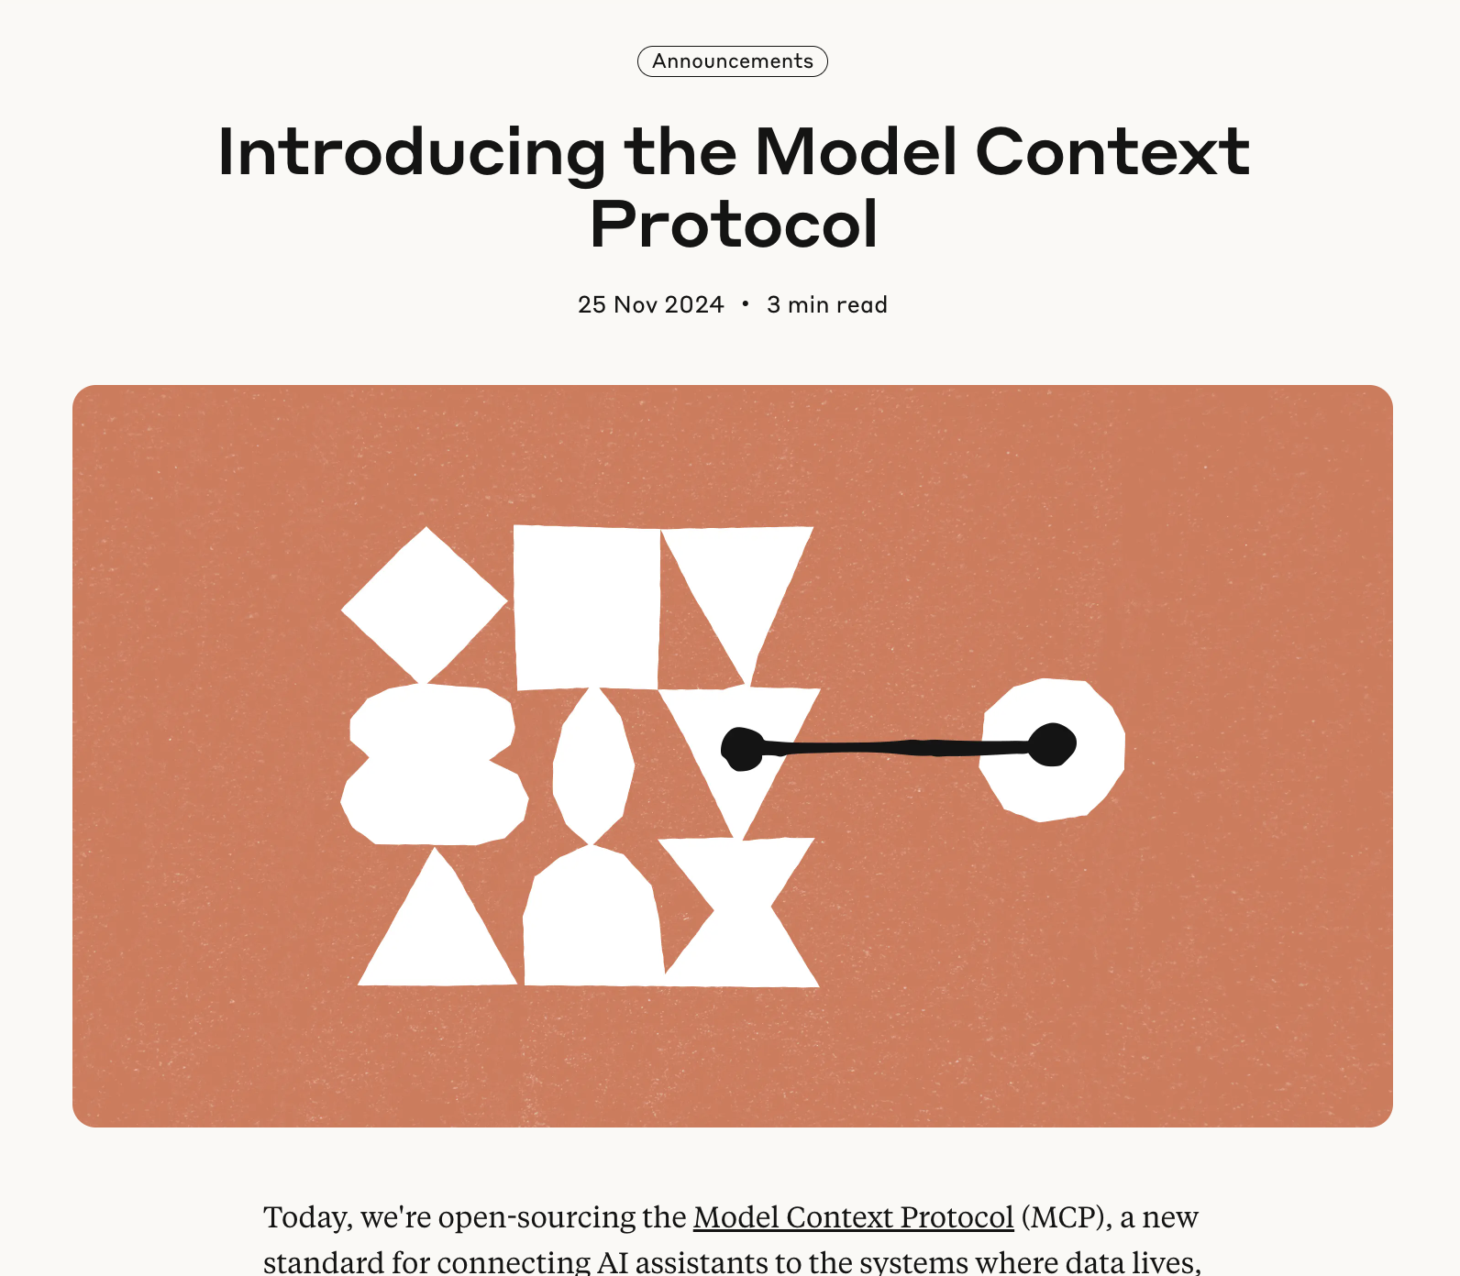
Model Context Protocol
The Problem MCP Solves:
AI assistants were isolated from data - trapped behind information silos and legacy systems, with every new data source requiring its own custom implementation, making truly connected systems difficult to scale.
Simple Analogy:
MCP is like a USB-C port for AI applications - just as USB-C provides a standardized way to connect devices to various peripherals, MCP provides a standardized way to connect AI models to different data sources and tools.

Slide 10
What is MCP?
The Model Context Protocol (MCP) is an open standard that allows large language models (LLMs) to communicate with external data, tools, and applications. It acts as a standardised interface, enabling AI agents to access resources like databases, search engines, and local files, so they can perform tasks beyond their initial training data.

Slide 11
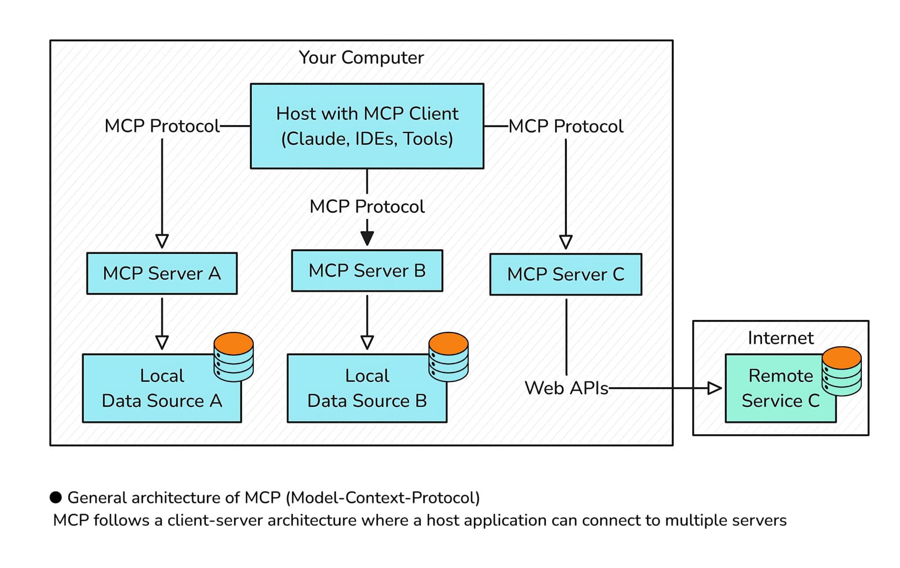
MCP Architecture
MCP Client:
MCP Clients are AI applications that connect to these servers to enhance their capabilities.
Discover what resources and tools are available
Make requests to servers on behalf of the AI
Handle the communication protocol
MCP Servers:
MCP Servers expose resources and capabilities to AI applications.
Resources: Data sources like files, databases, or API endpoints
Tools: Functions the AI can call to take actions
Prompts: Pre-written prompt templates

Slide 12
Hands-on Session
Claude Builder Club – Model Context Protocol Workshop

Slide 13

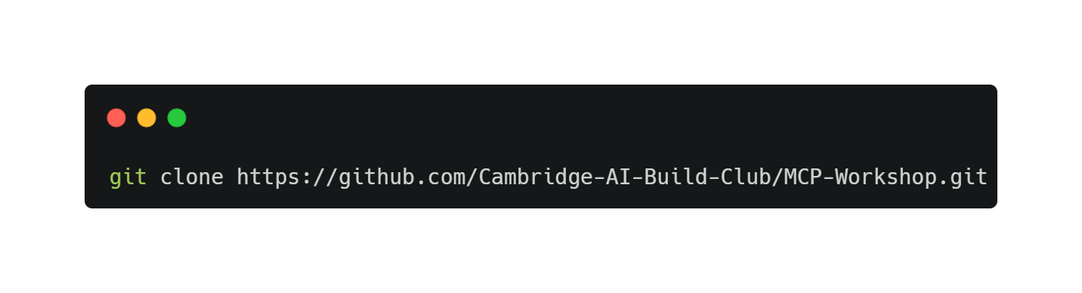
Workshop Materials

Slide 14
What are Skills?
Claude Builder Club – Skills Workshop

Slide 15
Skills
Skills are reusable, filesystem-based resources that provide Claude with domain-specific expertise: workflows, context, and best practices that transform general-purpose agents into specialists. Unlike prompts (conversation-level instructions for one-off tasks), Skills load on-demand and eliminate the need to repeatedly provide the same guidance across multiple conversations.
Key benefits:
Specialise Claude: Tailor capabilities for domain-specific tasks
Reduce repetition: Create once, use automatically
Compose capabilities: Combine Skills to build complex workflows
TL;DR. Skills are markdown files to teach Claude what to do and how to do it.

Slide 16
How Skills work
Level | When Loaded | Token Cost | Content
Level 1: Metadata | Always (at startup) | ~100 tokens per Skill | name and description from YAML frontmatter
Level 2: Instructions | When Skill is triggered | Under 5k tokens | SKILL.md body with instructions and guidance
Level 3+: Resources | As needed | Effectively unlimited | Bundled files executed via bash without loading contents into context

Slide 17
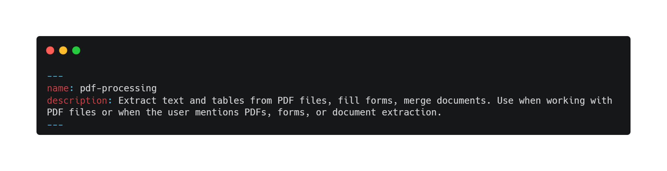
Level 1: Metadata

Slide 18
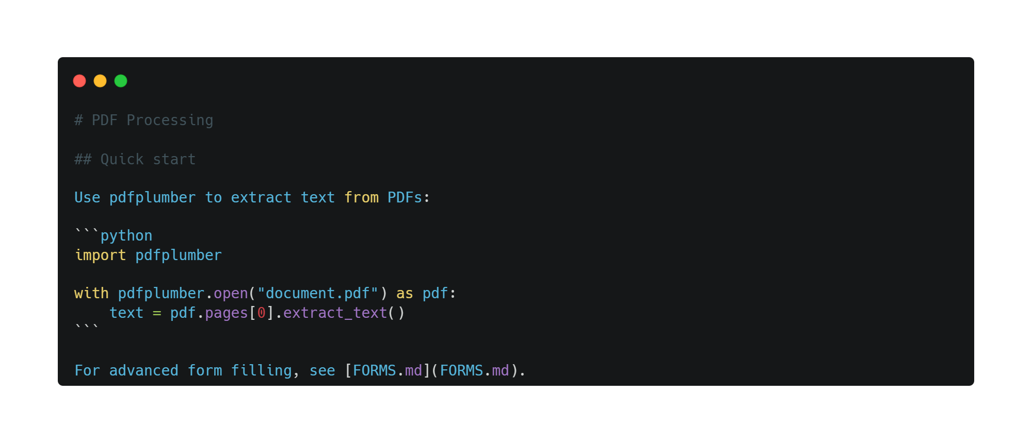
Level 2: Instructions

Slide 19
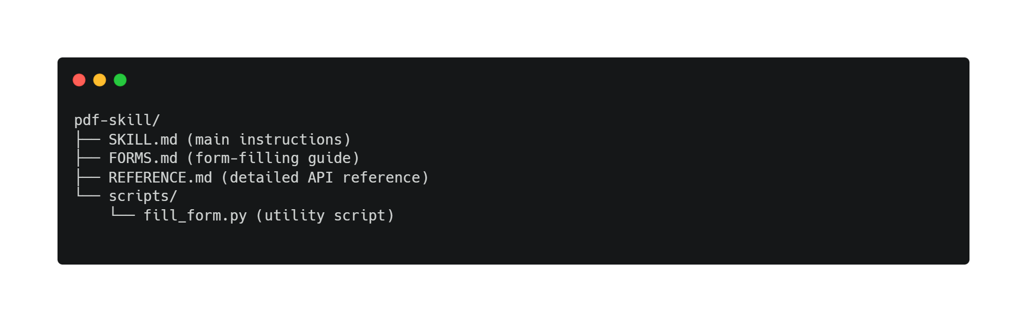
Level 3+: Resources

Slide 20
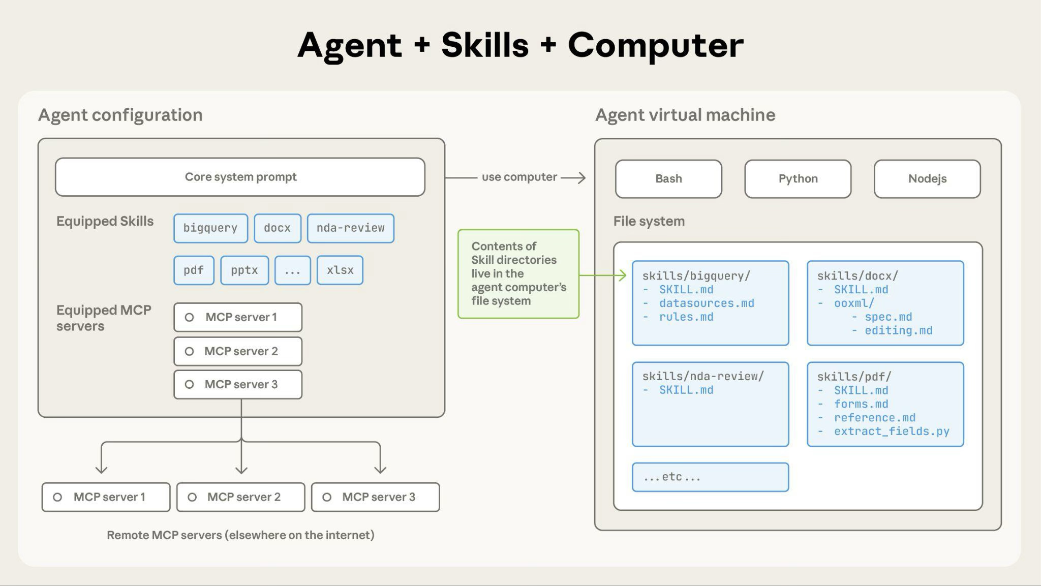

Slide 21
Example: Loading a PDF processing skill
Startup: System prompt includes: PDF Processing - Extract text and tables from PDF files, fill forms, merge documents
User request: "Extract the text from this PDF and summarise it"
Claude invokes: bash: read pdf-skill/SKILL.md → Instructions loaded into context
Claude determines: Form filling is not needed, so FORMS.md is not read
Claude executes: Uses instructions from SKILL.md to complete the task

Slide 22
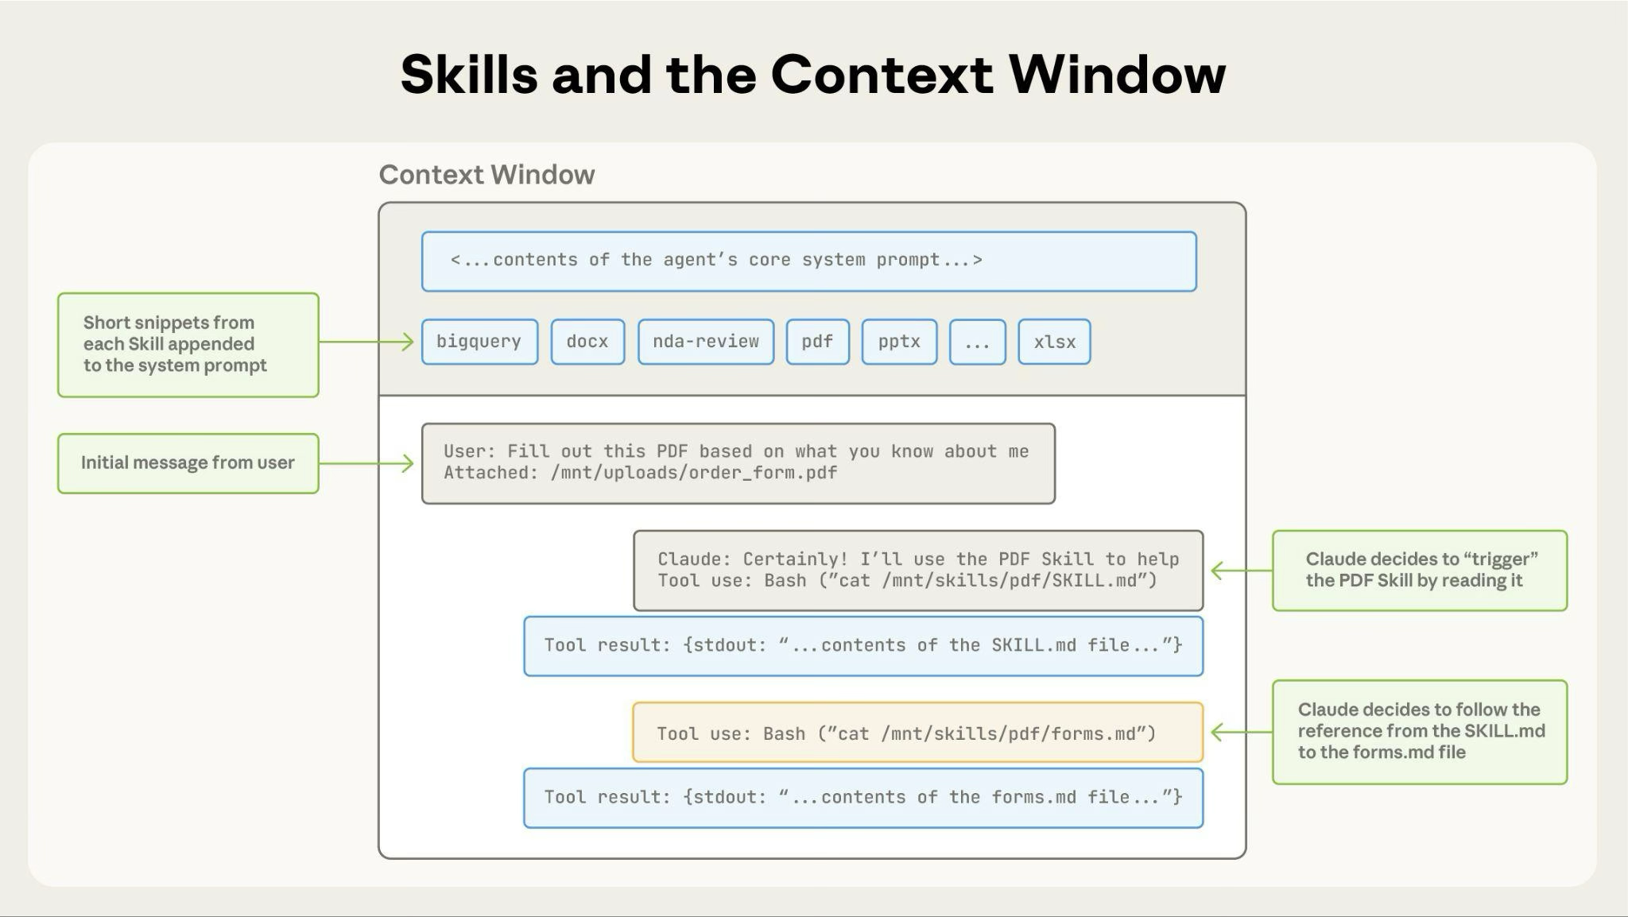

Slide 23
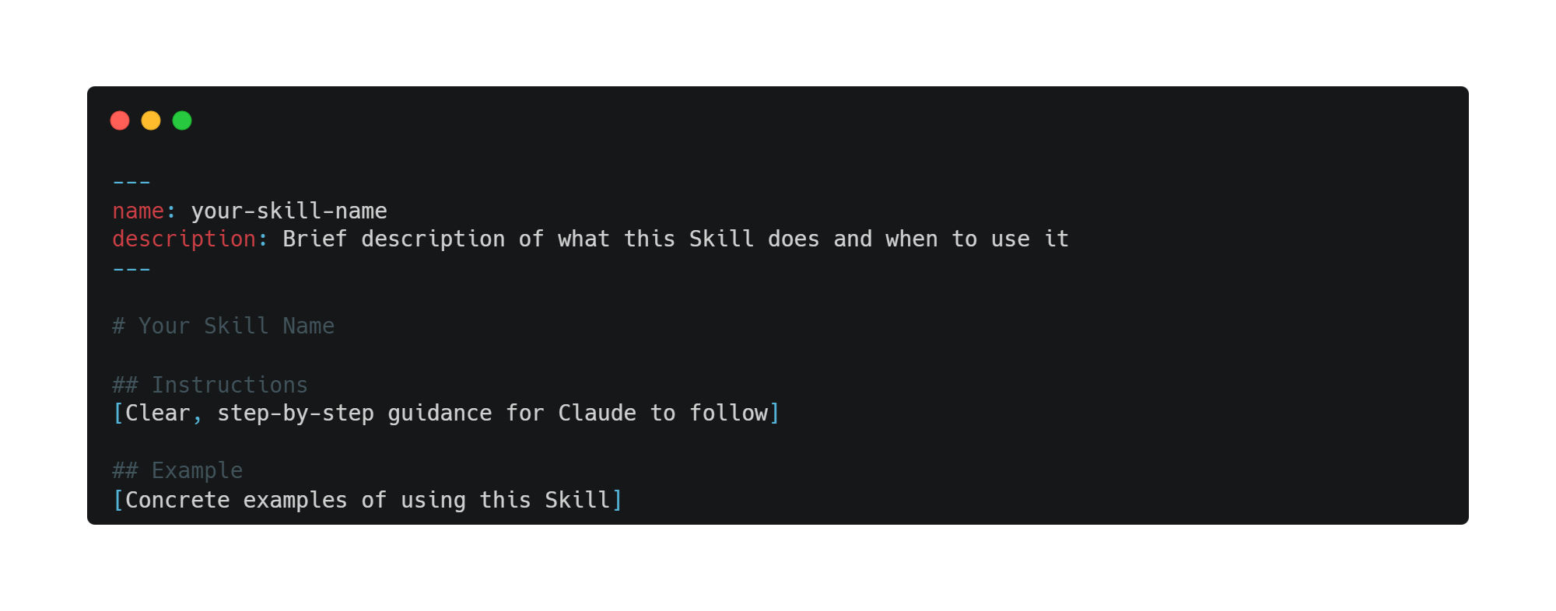
Skills structure

Slide 24
Skills structure
name:
Maximum 64 characters
Must contain only lowercase letters, numbers, and hyphens
Cannot contain XML tags
Cannot contain reserved words: "anthropic", "claude"

Slide 25
Skills structure
description:
Must be non-empty
Maximum 1024 characters
Cannot contain XML tags

Slide 26
How to write effective Skills
Claude Builder Club – Skills Workshop

Slide 27
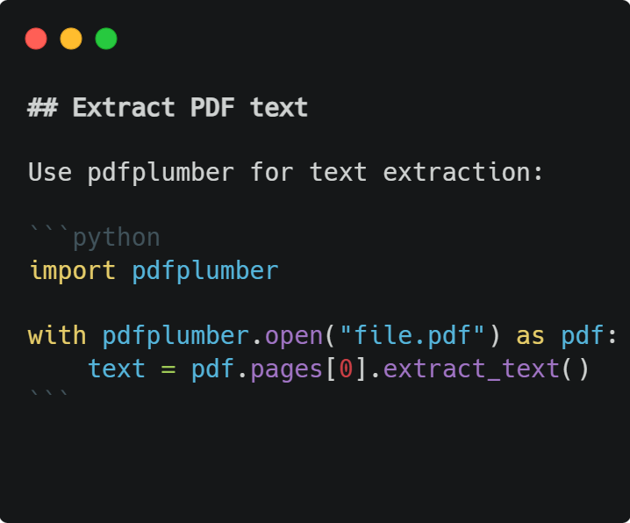
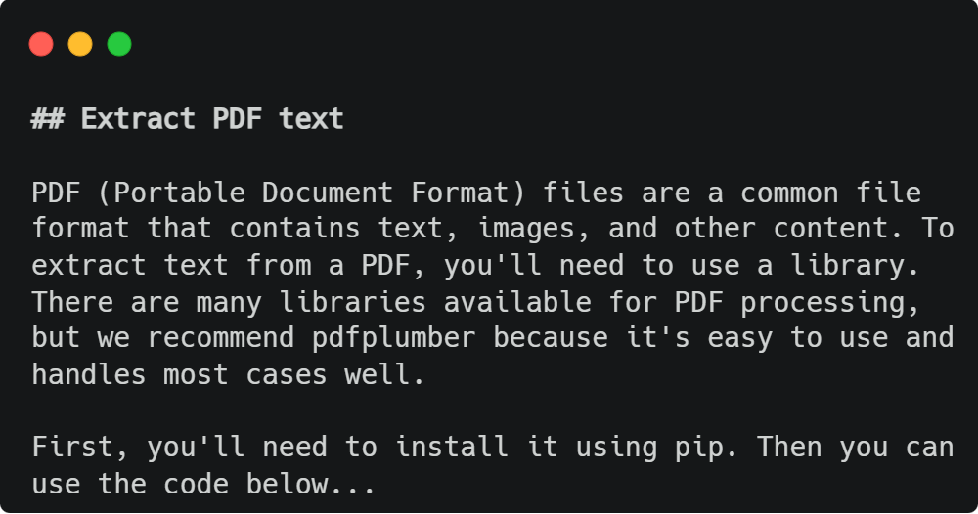
Conciseness

Slide 28
Degrees of Freedom
Freedom Level | When to Use | Example
High | Multiple approaches valid | Code review guidelines
Medium | Preferred pattern exists | Report templates
Low | Operations are fragile | Database migrations

Slide 29
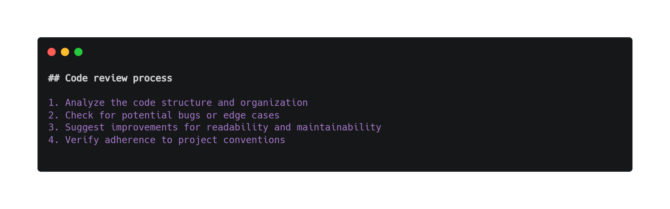
Degrees of Freedom – High

Slide 30
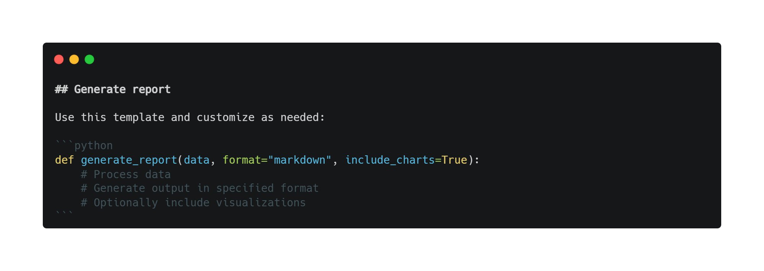
Degrees of Freedom – Medium

Slide 31
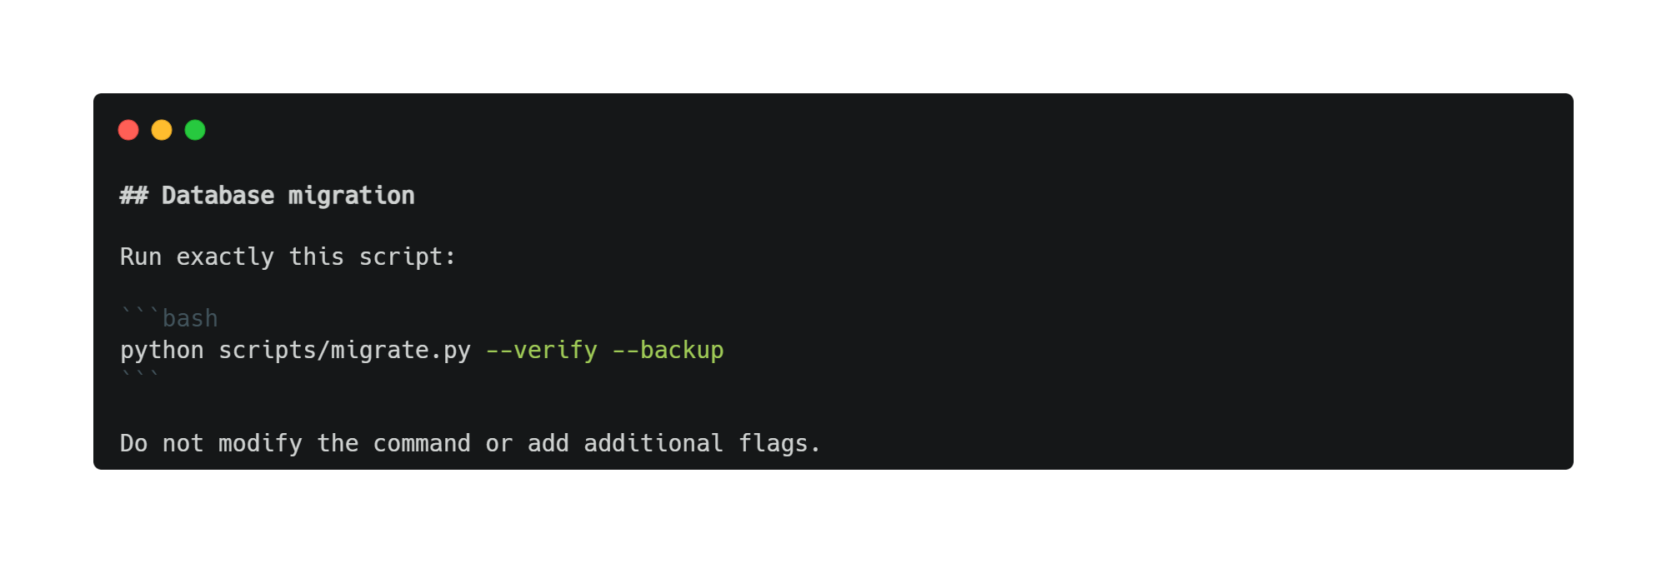
Degrees of Freedom – Low

Slide 32
Test with all models you plan to use
Testing considerations by model:
Claude Haiku (fast, economical): Does the Skill provide enough guidance?
Claude Sonnet (balanced): Is the Skill clear and efficient?
Claude Opus (powerful reasoning): Does the Skill avoid over-explaining?
What works perfectly for Opus might need more detail for Haiku. If you plan to use your Skill across multiple models, aim for instructions that work well with all of them.

Slide 33
Hands-on Session
Claude Builder Club – Skills Workshop

Slide 34
Thank you
Thank you

